Slide 1
Supporting Our Kids
What they want. What they need. What we need to give them.

Slide 2
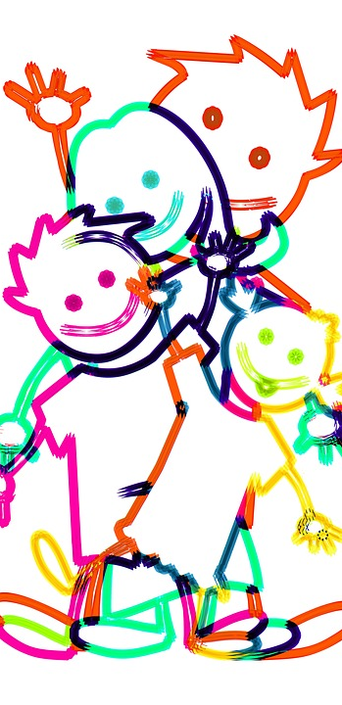
Outline
A Kid’s World
A Caregiver’s World
A Context for Mental Health
Understanding Stress and Anxiety
Protective Factors
A ‘Handy’ Model of the Brain
Understanding ‘Flipped’ Lids
How to Get Unflipped
The Importance of Self-Care

Slide 3
A Kid’s World
Limited opportunities for true rest
Social Media (Perfect image vs Reality)
Video Gaming (Designed stimulation)
YouTube/Media (Endless distraction)
Overscheduled (Outcome vs True Play)
Constant peer interaction
Busy and stressed caregivers
Confused expectations
One the one hand – “Act more grown up.”
On the other hand – “You’re just a kid.”
Too much information (Internet, Social Media, Over-sharing)
Notes:
Losing concept of public versus private (FB, Instagram)--Rachel

Slide 4
A Caregiver’s World
Limited opportunities for true rest
Social Media (Perfect image vs Reality)
Video Gaming (Designed stimulation)
YouTube/Media (Endless distraction)
Overscheduled (Outcome vs True Play)
Constant/Competing parenting advice (family, friends, ‘experts’)
Busy and stressed caregivers
Confused expectations
One the one hand – “Go easy on them.”
On the other hand – “You’re too easy on them.”
Too much information (Internet, Social Media)
Notes:
Rachel

Slide 5
A Context for Mental Health
Mental Illness/
Disorder
(Anxiety 6-10%, depression 4-6%)
Mental Distress
Something has changed/isn’t working
Necessary experiences for growth & adaptation
(i.e. Can’t find your keys, Not making the team, making a speech, big project )
“Life as usual” – No Distress/Problem/Disorder
(i.e. Hanging out with friends, reading a book, walking the dog)
Mental Problem
Response to more serious external events
(i.e. Moving, Loss of loved one)
Notes:
Background about MHL
Initiative started by Stanley Kutcher – adopted by PSSD to reduce stigma, increase understanding and improve help-seeking efficacy through teacher training, health curriculum and school/community– education-Tanya
Through media reports and public perception parents occasionally concerned about kids developing mental health issues - the pyramid helps provide a context for understanding MH as being broader than just ”Healthy or Ill” dichotomy
Can be in all four things at once – Diagnosed w/ depression, have a loved one just pass away, miss out on making the basketball team and be hanging out watching a movie with friends

Slide 6
How Anxiety Works
Notes:
Kutcher indicates if you have one exposure to something able to work your way through it then with second your system won’t activate as high – but in truth it may take repeated exposures before the system becomes accustomed to the experience -Tanya
Middle line – first exposure – if rescued (point A) then the next time they are exposed to similar situation then their system goes way higher and lasts much longer (Ex. Test worry – “It’s okay you don’t have to take it). If we can support them through that struggle then the system naturally regulates itself and then the next time they are exposed (bottom line on graph) their system doesn’t go as high or go for as long. Delicate dance between supporting them through a situation versus holding them in a situation that is too much for their system to regulate around/adapt to. How do I know the difference? It’s about knowing your kid and making best guesses – often better error on supporting them to give it a try but if observe continued escalation and extended duration - able back out of experience by “disagreeing with yourself”, getting the child regulated and trying it again at another time.

Slide 7
The Truth about Stress and Anxiety
Human beings naturally avoid experiencing pain (physical, emotional and psychological)
HOWEVER: In order to grow and change we need to experience adversity and have our comfort zone stretched
THEREFORE: Positive and Tolerable Stress are not inherently bad, it is our relationship to stress that can become problematic.
Looking at stressful situations as a “challenge” and an “opportunity” activates a different set of responses in our system – those geared for growth versus harm
Notes:
McGonigal’s book – Current understanding of human stress based research conducted on rats where they were repeatedly almost drowned - not surprisingly researchers discovered that it was bad for the rat’s systems – then took that information and applied it to all stress .--Tanya

Slide 8
Stress: From Positive to Toxic
Toxic: Prolonged; extreme (Rare) * in teenagers this could look like physical/sexual abuse; chronic neglect, violence; caretaker mental illness/substance abuse – without adequate adult support (complex outcomes) • DO NOT CONFUSE TOXIC STESS WITH POSITIVE OR TOLERABLE STRESS
Notes:
Tanya

Slide 9
Protective Factors: Helping kids manage hard things
When children feel they matter to their parents, what other people think of them matters less. We don’t need to save our children from the wounding world they live in-this is impossible. It is our job to make sure we don’t send them into it empty handed. At the root of resiliency, emotional vulnerability, and soft hearts lies a simple truth: whoever a child gives their heart to has the power to protect it with their own.
-Debbie MacNamara: Rest, Play, Grow
Notes:
Greatest protective factor (from bullying, grief, traumatic events) is having at least one adult in their lives they feel unconditionally loved by--Rachel

Slide 10
How To Be Your Child’s ‘Shield’
Come alongside your child’s upset with your physical presence i.e. tone of voice, the look in your eyes, physical closeness
Be responsible for maintaining the relationship
Create routines that foster connection (bedtime rituals, family mealtimes, helping with homework)
Explicitly telling your kids how much you care about them and why (it sounds obvious but when we’re busy we often forget)
Listen more, talk less
Be curious about what’s not working-focus on consequences that connect when consequences are necessary
Notes:
Rachel

Slide 11
A ‘Handy’ Model of the Brain
Notes:
Tanya

Slide 12
Understanding ‘Flipped’ Lids
When lids are attached kids can be kind, show genuine interest in things, be patient, show empathy
BUT kids are designed by nature to flip their lids on a regular basis and it’s the caregiver’s job to help put it back on
When kids flip their lids it’s an opportunity for us to guide them through the process of becoming regulated again
Kids fall apart where they feel the safest—consider it a compliment ☺
Regulate, relate, reason-Bruce Perry
Notes:
Tanya

Slide 13
‘Unflipping’ Our Lids
We are humans too and we have lids that flip
It’s important to give ourselves permission to ”time out” ourselves before we try to respond to a situation
When we need a time out it’s important not to give your child the message they are too much for you or that you don’t know how to handle them.
Find a reason to back out of the situation (Just remembered you need to put on laundry, you need to go to the washroom, you need to make them a snack)
It’s OK to tag team if that’s possible
Notes:
Tanya

Slide 14
We Can’t Give What We Don’t Have: Self -Care
To regulate yourself:
Paced breathing—Breathe out longer than you breathe in
Shock your system—splash some cold water on your face
Notice 5 things you can see, 5 things you can hear, and 5 things you can physically feel
Find your feet
Remember what matters-–connecting to your values helps make tough times worth it
Notes:
Rachel

Slide 15
Resources Used in this Presentation
Kids These Days by Jody Carrington
Mental Health Literacy by Stan Kutcher (teenmentalhealth.org)
Rest, Play, Grow by Debbie Macnamara
The Hand Model of the Brain by Dan Siegel (youtube https://www.youtube.com/watch?v=gm9CIJ74Oxw)

Slide 16
Other Helpful Resources
Anxious Kids Anxious Parents by Reid Wilson and Lynn Lyons
The Upside of Stress by Kelly McGonigal
The Whole-Brain Child by Dan Siegel

